Slide 1
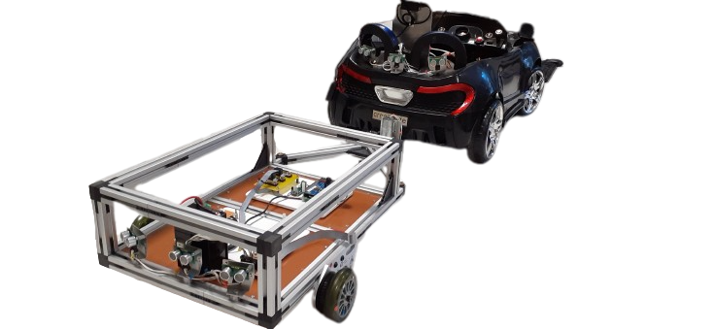
TrailerMate
Team Jason
Abdessamad Amadar
Malaurie Bernard
Sarah Bobillot
Emilie Fraumar
Killian Gonet
Réda Kharoubi
Antonin Laborde-Tastet

Slide 2










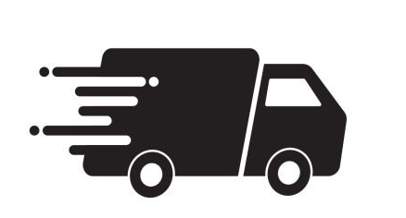


Table of content
02/17
TrailerMate – Review 0
Context
Product description
Main features
Release vision and backlog
Sprint 1
Risk analysis
Operationnal requirement
Questions ?
Freight represents
30%
of French road transport
in 2021, French truck drivers travelled an average of 467 km per day, equivalent to 11h and 22 min on the road
500,000 road accidents are caused by tractor-trailers, resulting in 5,000 deaths, every year in the US
20% of truck drivers admit to have fallen asleep while driving

Slide 3

Table of content
Context
03/17
Sarah
Product description
Main features
Release vision and backlog
Freight represents
30%
of French road transport
in 2021, French truck drivers travelled an average of 467 km per day, equivalent to 11h and 22 min on the road
500,000 road accidents are caused by tractor-trailers, resulting in 5,000 deaths, every year in the US
Sprint 1
Risk analysis
s
Operationnal requirement
20% of truck drivers admit to have fallen asleep while driving
Autonomous truck modelized by a car and its trailer
Making truck driver's
lives and works easier
thanks to
a reverse gear library
Helping reduce accidents
thanks to an autonomous nagivation
and a security system

Slide 4
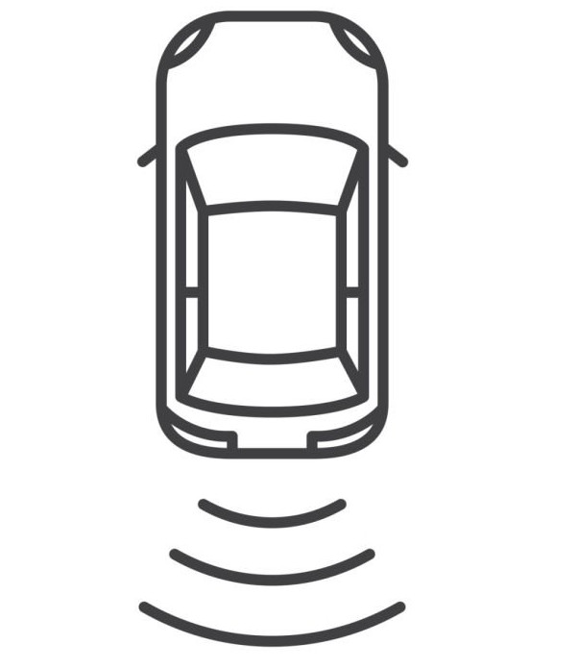


Context
Product description
04/17
Sarah
Autonomous truck modelized by a car and its trailer
Making truck driver's
lives and works easier
thanks to
a reverse gear library
Helping reduce accidents
thanks to an autonomous nagivation
and a security system
Reverse maneuver & Parking assistance
Perform a straight reverse gear during at least 10 meters
Perform a reverse gear with a 90 degrees angle turn and no constraint concerning the width of the road
Be able to detect the parking slot and park automatically
Autonomous navigation
The vehicle can detect obstacles while going forward
The vehicle (trailer) can detect obstacles while reversing
The vehicle can autonomously go from point A to point B using GPS
Security
Emergency stop switch in the controller
Switching to manual control when the vehicle is in automatic mode

Slide 5
Main features
Antonin
05/17
Release vision and backlog
Reverse maneuver & Parking assistance
Perform a straight reverse gear during at least 10 meters
Perform a reverse gear with a 90 degrees angle turn and no constraint concerning the width of the road
Be able to detect the parking slot and park automatically
Autonomous navigation
The vehicle can detect obstacles while going forward
The vehicle (trailer) can detect obstacles while reversing
The vehicle can autonomously go from point A to point B using GPS
Security
Emergency stop switch in the controller
Switching to manual control when the vehicle is in automatic mode
Project separate into 6 sprints lasting 2 weeks
Sprint 1-2-3-4-5 : product development according to the user story and the planification made in the sprint 0
SPRINTS
Sprint 0 : Discovering the project, the car and the expectations of our teacher-clients and project plan development

Slide 6

Release vision and backlog
06/17
Réda
Project separate into 6 sprints lasting 2 weeks
Sprint 1-2-3-4-5 : product development according to the user story and the planification made in the sprint 0
Sprint 0 : discovering the project, the car and the expectations of our teacher-clients and project plan development
SPRINTS
 |  | ...GOAL!
1
2
3
Familiarize oneself with the car's structure
Focus on the control laws of the car
Obstacle detection and addition of the trailer to the system
4
5
Automatically park the car with the trailer
Implement a
GPS function in our final product
Notes:
Now, we will talk about the release vision and backlog, in my case more precisely about the release vision.
Project separate into 6 sprints lasting for each sprint 2 weeks. A sprint is a period of time during wich we will work on the project with the aim of completing several missions that we planned upstream.
So split the project into several sprints will allow us to organize better and make the project more affordable.
So the sprint 0 is the initialization of the project, finally it is a step of preparation.

Slide 7
Release vision and backlog
07/17
Réda
SPRINTS
 |  | ...GOAL!
1
2
3
Familiarize oneself with the car's structure
Focus on the control laws of the car
Obstacle detection and addition of the trailer to the system
1
4
5
Automatically park the car with the trailer
Implement a
GPS function in our final product
Notes:
This is a global vision of our differents sprints summarized in a few words.
Use in addition to the system : the trailer
Now I’m leaving the floor for my colleague who will talk about the missions contained in these differents sprint with the backlog

Slide 8
Context
Product description
Main features
Release vision and backlog
08/17
Emilie
Sprint 1 Sprint 2 Sprint 3
Sprint 1
High priority
Moving forward with a fixed speed
Make a model of the car in Matlab/Simulink
Car can detect obstacles
Get an emergency button in the controller
Implement basic controls to controller
Ride a straight reverse gear during at least 10 meters
Understand the pre-existing code
Car adapt its speed to a manually or automatically
Trailer can detect obstacles
Centralizing the code on ROS 2
Implement all the control laws in Matlab
Get back the controller manually when the car is in automatic mode
Get values from sensors
Car take curves following the sensor value
Low priority
Looking for existing trailers control loops
Ride a reverse gear with a 90 degrees angle and no constraint
Make an interface to give error information to user
Go to point A to point B autonomously using GPS
Be able to detect the parking slot and park automatically
Make an application to get the planned trajectory in top view
Car can stop itself when there is an obstacle
Ride a reverse gear with a 90 degrees angle and a constraint
Car can avoid obstacles
Detect traffic signs and adapt the behavior of the car to it
Notes:
To organise our work, we defined some technical tasks and user stories which will allow us to realize all our features. These technical tasks and user stories are regrouped on the backlog. With the backlog we have a look on the whole project thank to the priority of each task. The highest priority above and the lowest below.
First sprint → will be detailed in few moment by Killian
Third sprint →

Slide 9
Context
Product description
Main features
Release vision and backlog
09/17
Emilie
Sprint 4 Sprint 5
Sprint 1
High priority
Ride a reverse gear with a 90 degrees angle and no constraint
Make an interface to give error information to user
Go to point A to point B autonomously using GPS
Be able to detect the parking slot and park automatically
Make an application to get the planned trajectory in top view
Car can stop itself when there is an obstacle
Ride a reverse gear with a 90 degrees angle and a constraint
Low priority
Car can avoid obstacles
Detect traffic signs and adapt the behaviour of the car to it
Notes:
Sprint 5 → no task with high priority

Slide 10

Context
Product description
Main features
Release vision and backlog
Sprint 1
Killian
10/17
Risks analysis
SCRUM Master : Killian Gonet
3 goals
Understand car structure
Design basic tasks
Use sensors/controller
3 goals
Existing code
Move forward/backward
Emergency button
ROS2 structure
SoA reverse control loops
Get values from sensor
Notes:
Existing code : Code existing to do very basic tasks + code to use sensors
ROS2 : Middleware to link all the sensors/CPUs/actionners in an « easy » way
Move forward/backward in a fixed speed (controller + motors working)
Littérature review on reverse control loops
Emergency button : Important if our code is bad/dirty ☺
Get values from sensor : Find a way to access to sensor values in all codes we’ll develop after
Not team clearly defined at the start because we all need to understand the global structure
Three teams after : One for reverse control loops, one for sensors and one for sensor values

Slide 11





Context
Product description
Main features
Release vision and backlog
Sprint 1
Risk analysis
Killian
11/17
Prevent project’s problem
4 example of tools
XProgramming : program in pairs
Test Driven Development
Early Feedback : communication with client
Error detection management
Notes:
Risk analysis in a nutshell : prevent project’s problem
Xprogramming : two people : one code, one observe the one who code and give feedback on the code
TDD : write test before start developing the code (for example write the code to test if the car goes to 5 km/h forward before writing the code to go forward)
Early feedback : communication with client before the end of the sprint
Error detection management : Think about the errors before they occurs -> Details to Abdessamad

Slide 12





Context
Product description
Main features
Release vision and backlog
Sprint 1
Risk analysis
Abdessamad
12/17
The five Essential Characteristics of Risks
1
Scope of the risk (Internal ,External, Material)
2
Description of the risk
3
Probability of occurrence
4
Criticity
5
Action to solve
Risks identification
Internal
External
Material
A teammate is sick and can’t work
The demonstration doesn’t work during sprint review
A sensor stop working
High
Very high
High
Medium
High
Medium
Replan his tasks / Discuss with client
Make a backup video
Develop detection system / emergency button

Slide 13


Context
Product description
Main features
Release vision and backlog
Sprint 1
Risk analysis
Abdessamad
13/17
Risks identification
Internal
External
Material
A teammate is sick and can’t work
The demonstration doesn’t work during sprint review
A sensor stop working
High
Very high
High
Medium
High
Medium
Replan his tasks / Discuss with client
Make a backup video
Develop detection system / emergency button
Reverse gears
Reverse straight line for at least 10 meters without deviation
Parking in a place facilitated by markers

Slide 14







Context
Product description
Main features
Release vision and backlog
Sprint 1
Risks analysis
Operationnal requirement
Malaurie
14/17
Questions ?
Reverse gears
Reverse straight line for at least 10 meters without deviation
Parking in a place facilitated by markers
Obstacle avoidance
1st step
> 30 cm
2nd step
)
)
)
Notes:
Operationnal requirements -> technical needs for our final product + validation tests designed to be sure we met the objectives
Truck arrives in front of the parking spot, detect orange diamond and then all by itself park in the parking spot (stops when it detect last markers
Backward really slowly without any deviation of the trailer -> main goal of our project

Slide 15


Context
Product description
Main features
Release vision and backlog
Sprint 1
Risks analysis
Operationnal requirement
Malaurie
15/17
Questions ?
Obstacle avoidance
1st step
> 30 cm
2nd step
)
)
)
Emergency
< 0,6 sec
Notes:
1st test -> car moving, detect obstacle and stop at least thirty centimeters away from the obstacle
2nd test -> car moving, detect obstacle and lower its speed + change trajectory and go back on its way

Slide 16




Context
Product description
Main features
Release vision and backlog
Sprint 1
Risks analysis
Operationnal requirement
Malaurie
16/17
Questions ?
Emergency
< 0,6 sec
Notes:
Expect the car to be able to stop at any time -> button include in the truck and accessible for the drivers For now, button on the controller ,,,, 0,6 second car fully stopped

Slide 17
Context
Product description
Main features
Release vision and backlog
Sprint 1
Risks analysis
Operationnal requirement
Questions ?
TrailerMate – Review 0
17/17
Notes:
Thank you all for your attention, please do not hesitate if you have any questions about our projects, we’ll be glad to answer you.

